Slide 1
PCS Connects Parent Orientation
August 2021

Slide 2
What is PCS Connects?
PCS Connects is Pinellas County School’s one to one student device initiative.
Students in grades three through ten will be assigned a Dell laptop to be used during the school day and at home.
Digital resources will be embedded in daily face to face instruction to facilitate research, creation, critical thinking and collaboration.
The devices will also be available to extend learning after school hours for enrichment and reinforcement of the curriculum.

Slide 3
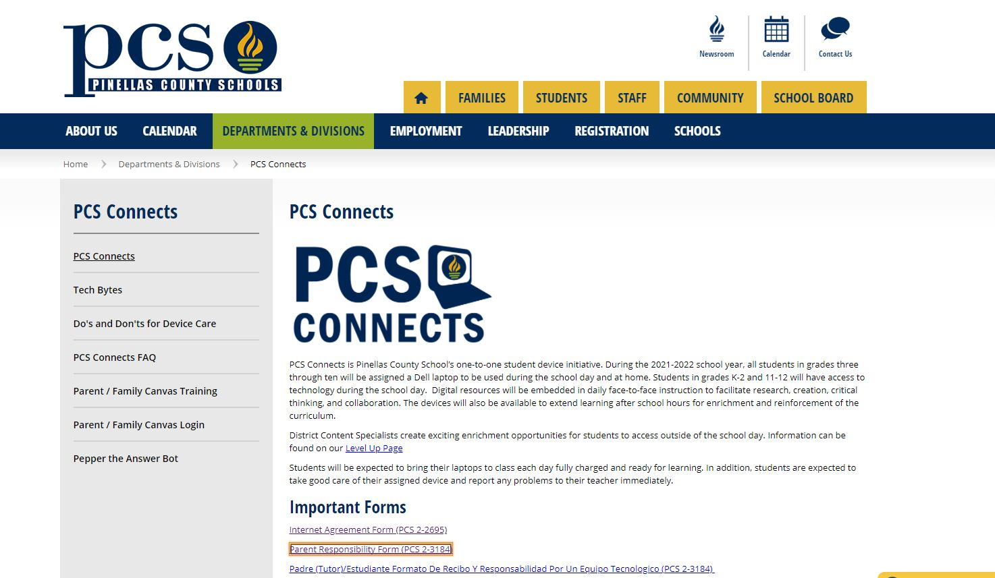
Visit the PCS Connects website
For more information including:
Tech Support for Parents
FAQs
Parent Canvas access
Tech Bytes (short videos)

Slide 4
Responsibility for and care of the laptop
The PCS Connects laptop is an important instructional resource. Just like textbooks and library books, students are responsible to take care of and not lose or damage the device.
Students should bring their device to class each day fully charged and ready for learning.
Just like with textbooks, students are expected to return their assigned devices in good working order. Parent/Student Responsibility Form

Slide 5
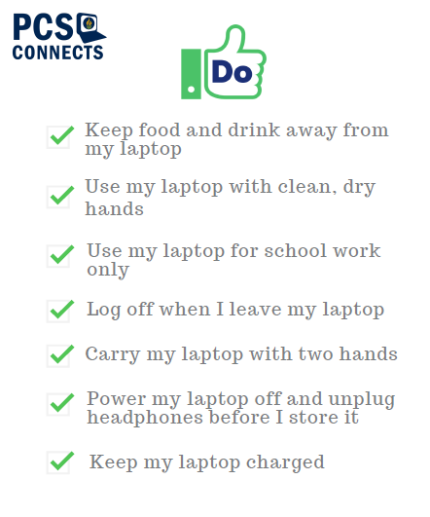

Slide 6
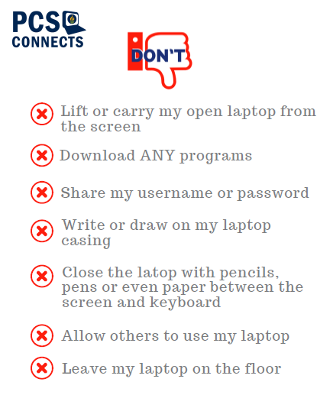

Slide 7
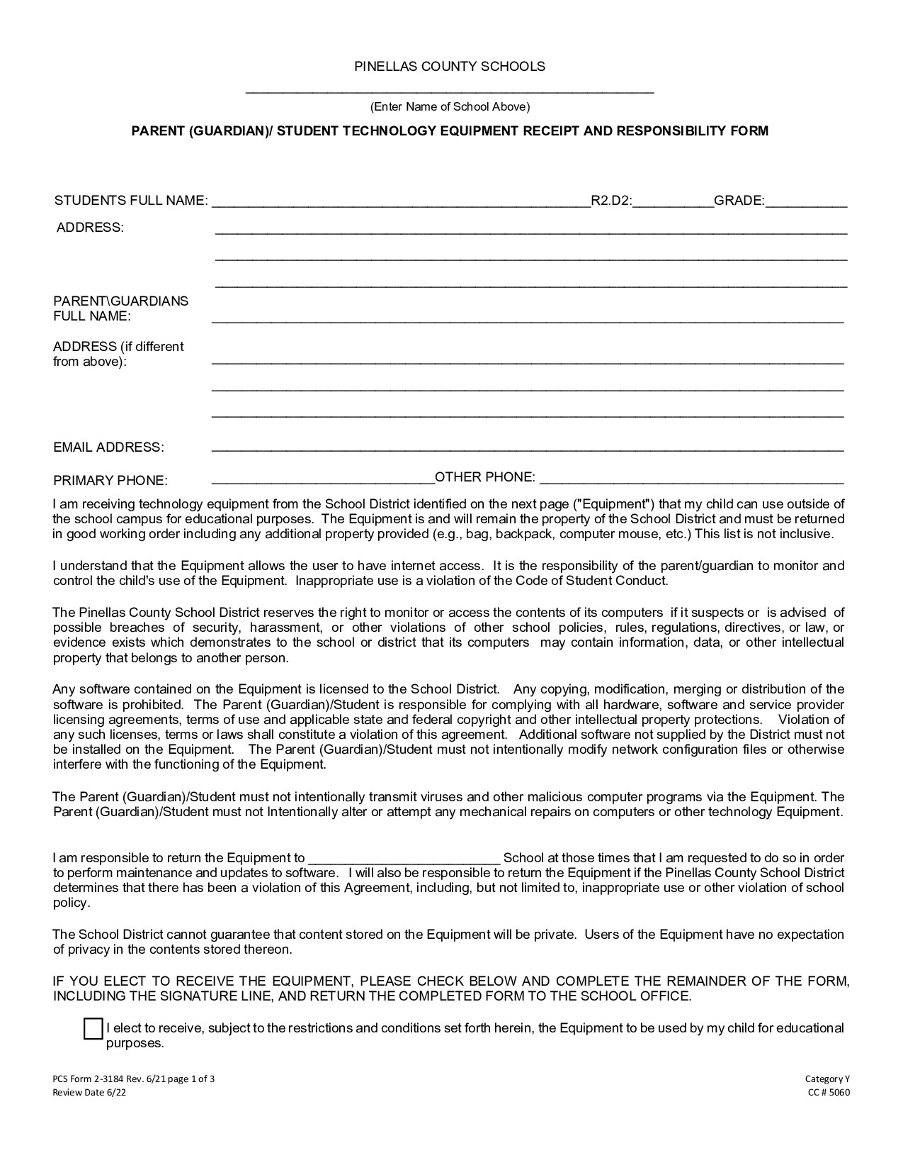





Slide 8
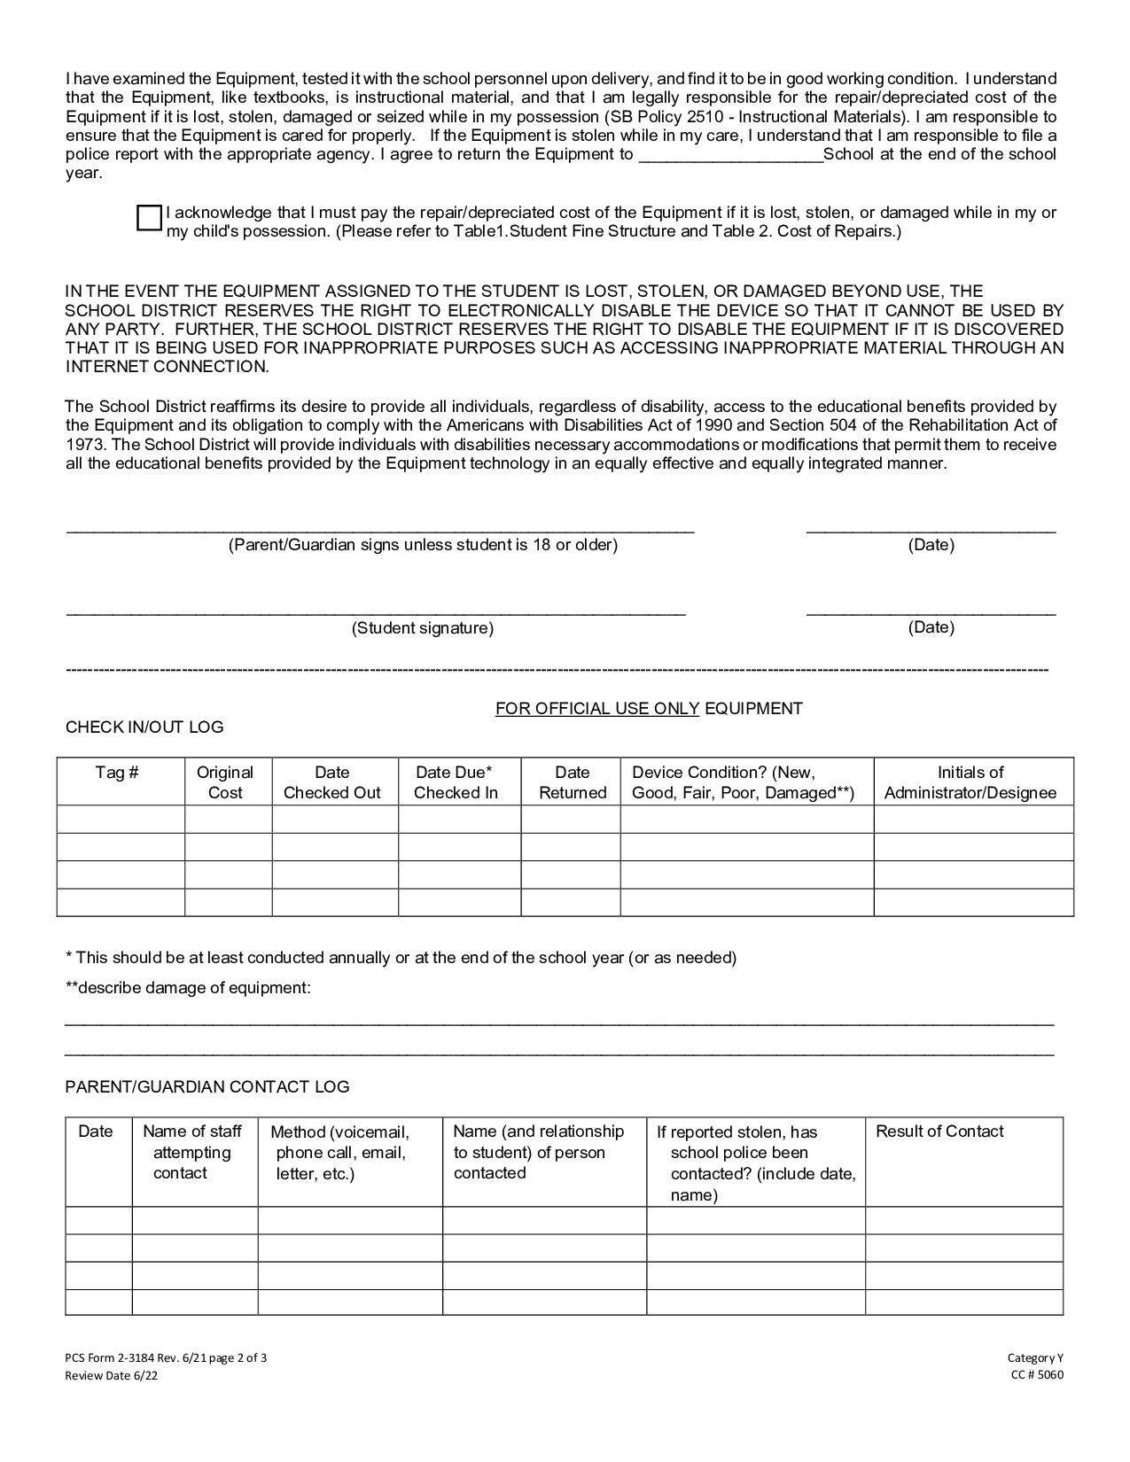




Slide 9
